Slide 1
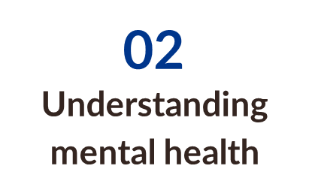
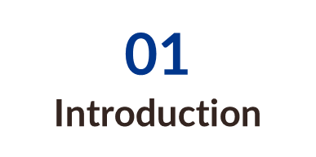

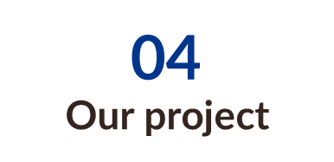
Elevated Mind
Table of contents
Process​
03

Slide 2

Table of contents
Elevated Mind
Process​
03

Slide 3
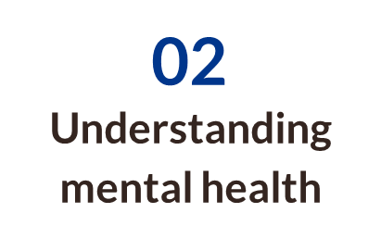
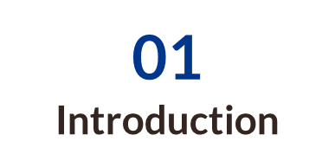
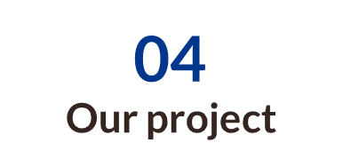
Process​
03

Slide 4
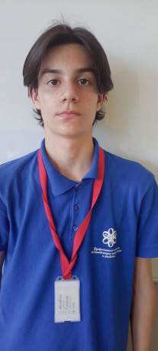
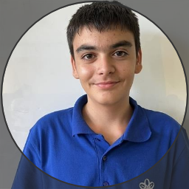
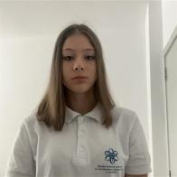
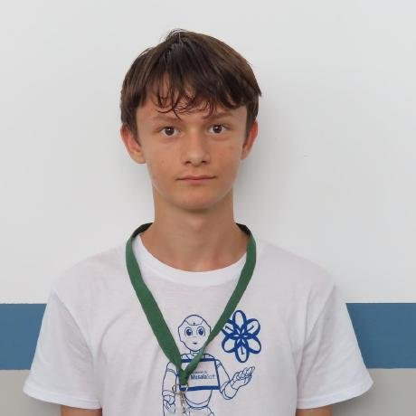
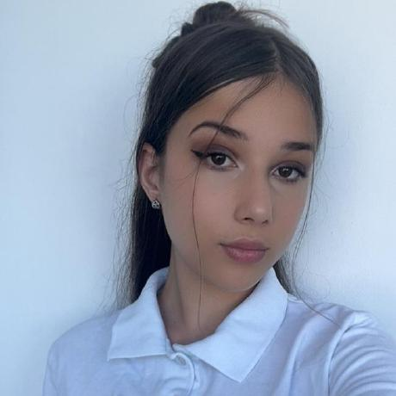
Team members
Ivaylo Gyurov
(Researcher and Ethicist)
Rostislav Nikolov
(Design Thinker)
Yoana Georgieva
(Data Analyst)
Ivelin Metodiev
(BackEnd Developer)
Valeria Vulchanova
(FrontEnd and Prorotyping)

Slide 5
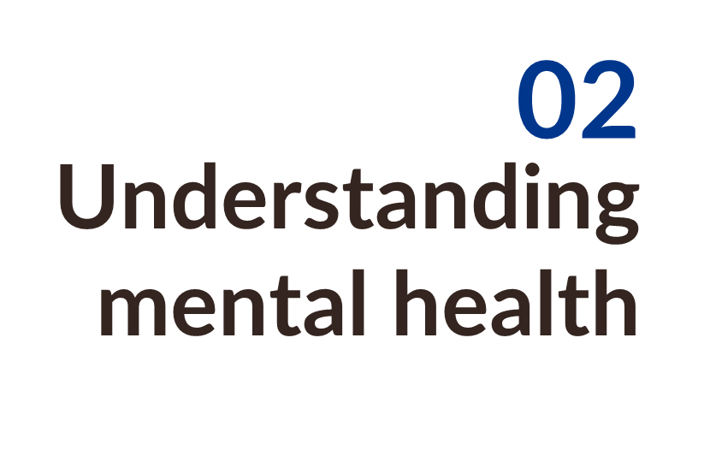

Slide 6


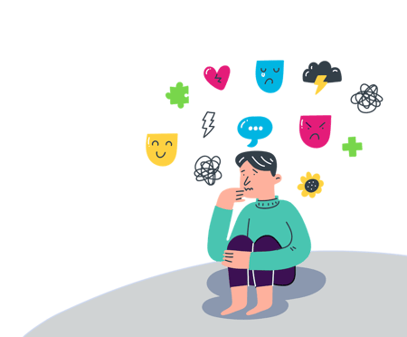
Mental health website
Process​
03
Struggling with your mental health? Our AI-powered chatbot is here to support you. Get instant, confidential guidance on stress, anxiety, self-care, and more. Ask questions, receive personalized advice, and take steps toward a healthier mind—anytime, anywhere.

Slide 7
Structure
Process​
Business understanding
Data understanding​
03
Data preparation​
Modeling
Evaluation
Deployment​

Slide 8
Process
Process​
03
Discuss the idea
Create the AI model and Website
Search for Data
Connect the AI model and Website
Present​ing
Create design

Slide 9
04
Our project​

Slide 10
Thank you for having us!

Slide 11
Thank you for having us!

